Slide 1
How feedback influences galaxy redshift-space distortions
Jim van Veenhuyzen, 11-6-2024
Project Supervisor: Dr. Marcel van Daalen

Slide 2
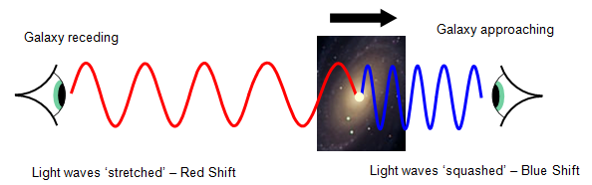
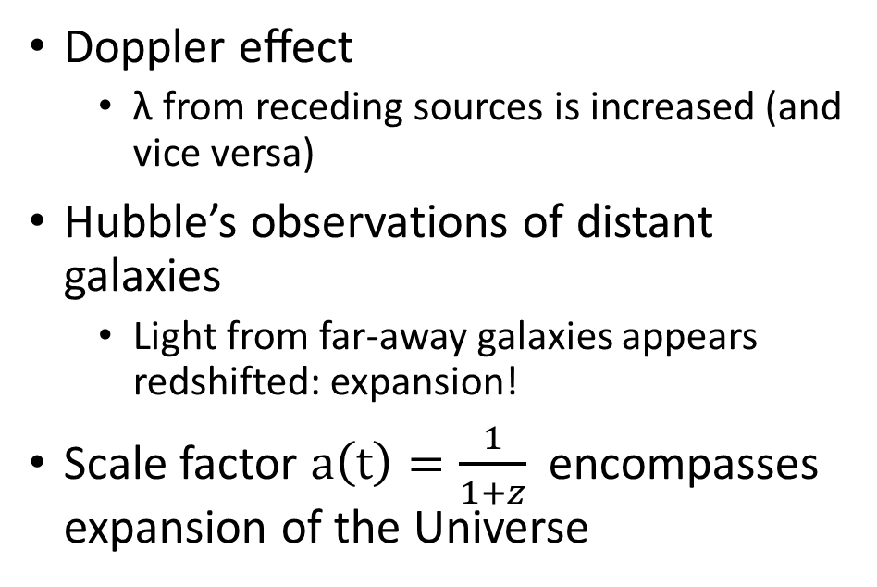
Introduction: Galaxies and expansion
Doppler effect
λ from receding sources is increased (and vice versa)
Hubble’s observations of distant galaxies
Light from far-away galaxies appears redshifted: expansion!
Scale factor $a\left(t\right)=\frac{1}{1+z}$ encompasses expansion of the Universe

Slide 3
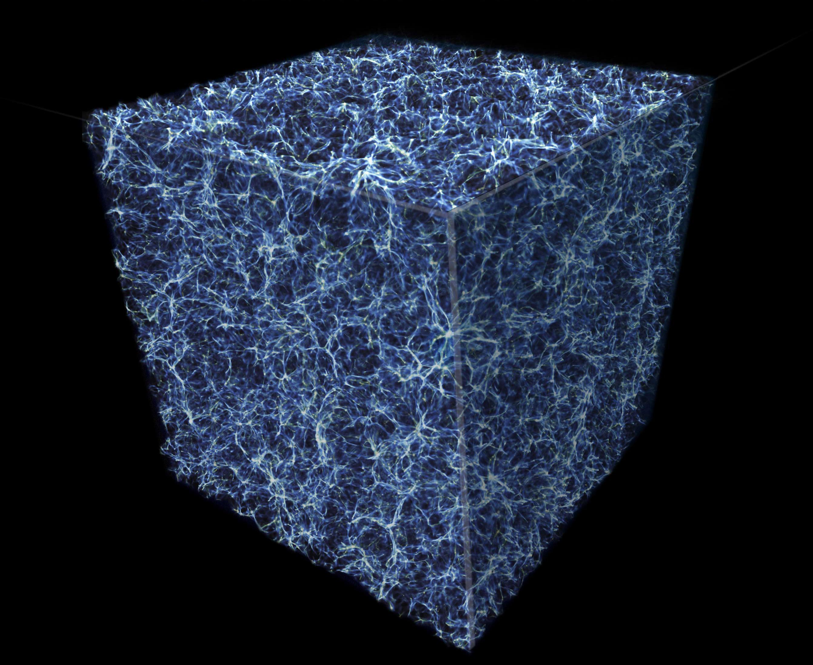
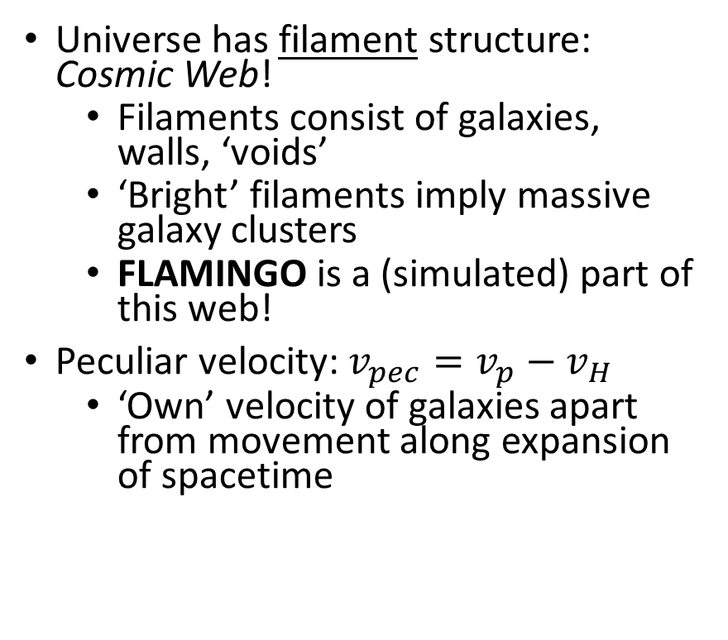
Introduction: The universe at the largest scale
Universe has filament structure: Cosmic Web!
Filaments consist of galaxies, walls, ‘voids’
‘Bright’ filaments imply massive galaxy clusters
FLAMINGO is a (simulated) part of this web!
Peculiar velocity: $v_{pec}=v_{p}−v_{H}$
‘Own’ velocity of galaxies apart from movement along expansion of spacetime
Notes:
We recover the metric tensor if we take a(t)=1 (steady state cosmology)

Slide 4
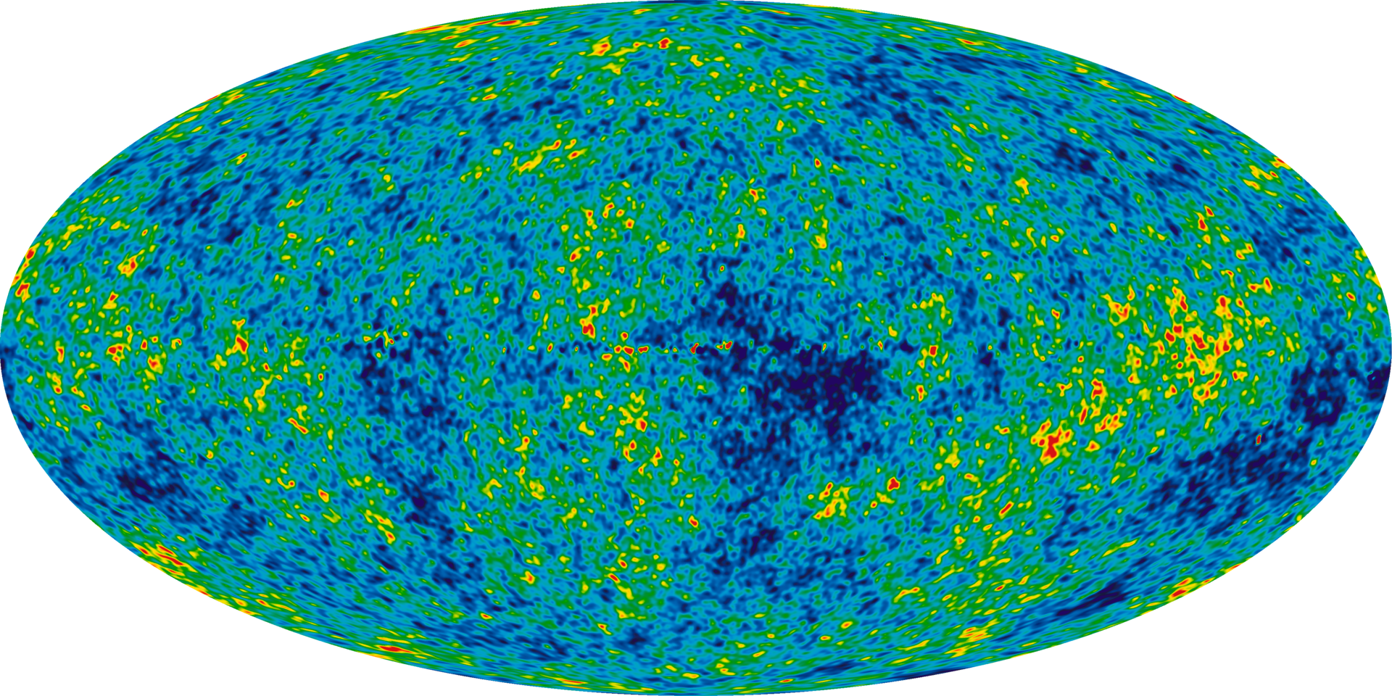
Introduction: Power spectrum
Density fluctuation strength P(k) as a function of scale k [h/Mpc]
Fourier Transform of density contrast δ(x)
Allows us to quantify the anisotropy of galaxies inside FLAMINGO!
Now that we have the background covered…

Slide 5
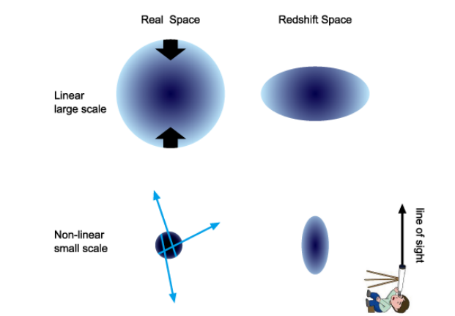
Introduction: Redshift-Space Distortions
Two ‘distortion’ effects occur on both small and large scales
Both of these ‘RSD’ effects perturb Hubble’s law
Infalling motion of galaxies toward cluster center on large scales: Kaiser effect
Virialized velocity dispersions of galaxies inside clusters on small scales: Fingers-of-God

Slide 6
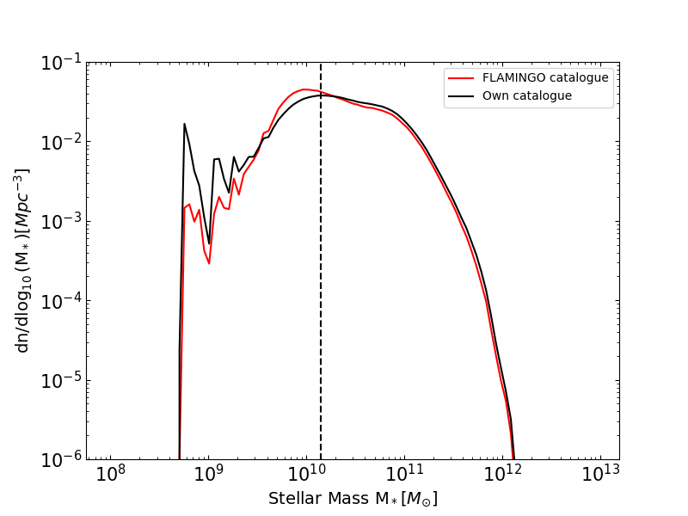
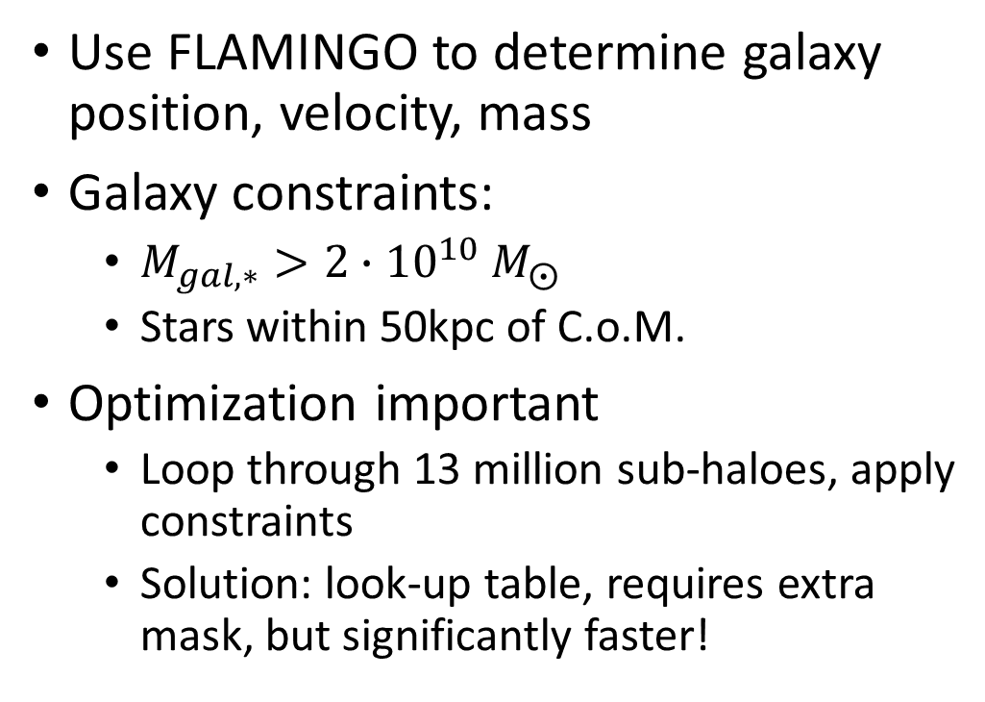
Methods: Creating a galaxy catalogue
Use FLAMINGO to determine galaxy position, velocity, mass
Galaxy constraints:
$M_{gal,∗}>{2∙10}^{10} M_{⨀}$
Stars within 50kpc of C.o.M.
Optimization important
Loop through 13 million sub-haloes, apply constraints
Solution: look-up table, requires extra mask, but significantly faster!

Slide 7
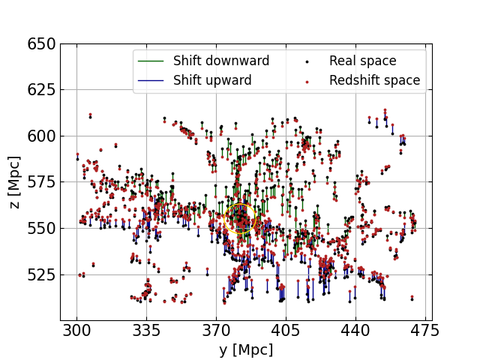
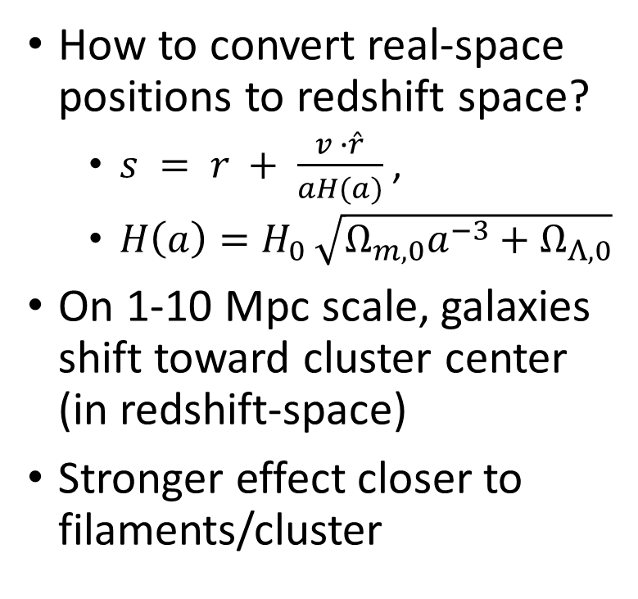
Methods: Redshift-space positions
How to convert real-space positions to redshift space?
$s = r + \frac{v ∙\hat{r}}{aH(a)}$,
$H\left(a\right)=H_{0 }\sqrt{Ω_{m,0}a^{−3}+Ω_{Λ,0}}$
On 1-10 Mpc scale, galaxies shift toward cluster center (in redshift-space)
Stronger effect closer to filaments/cluster

Slide 8
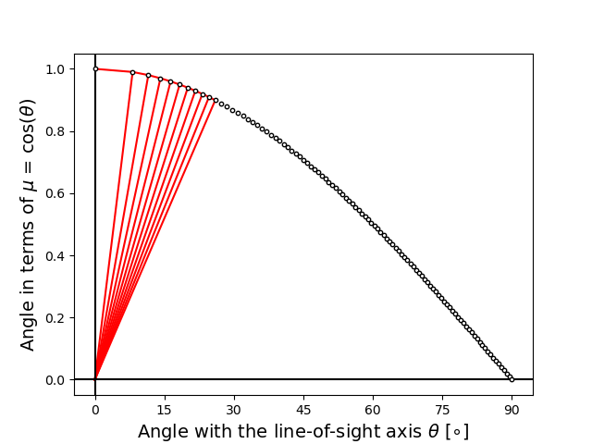
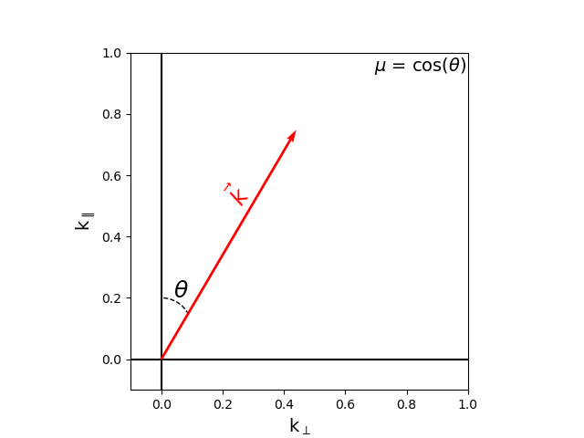
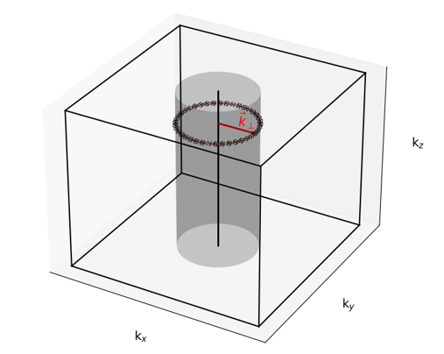
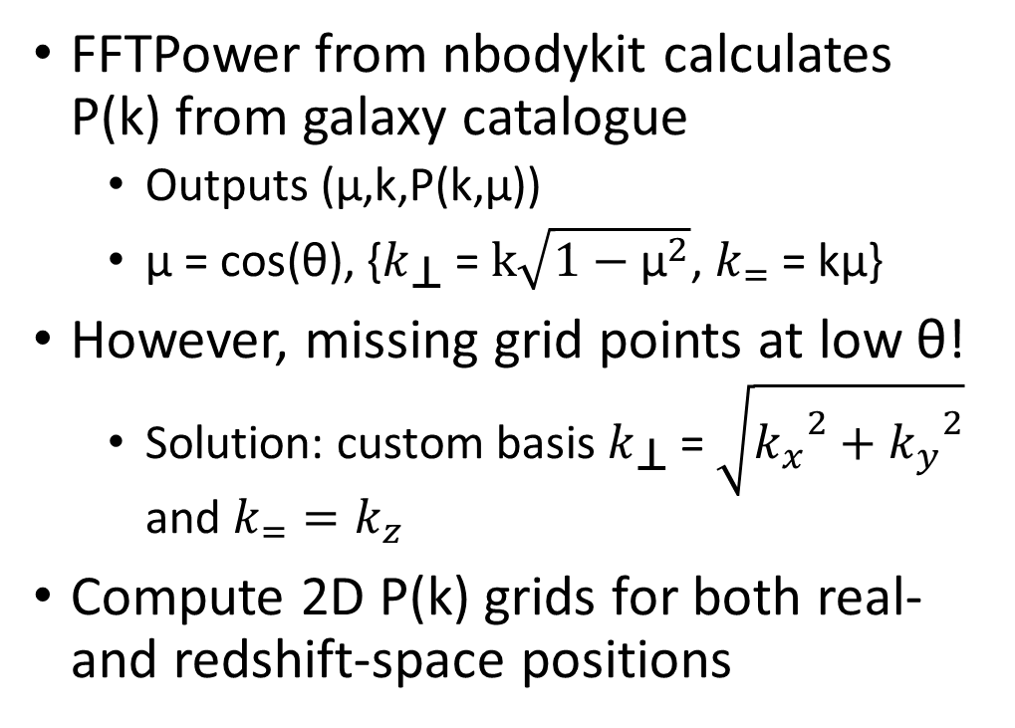
Methods: 2D power-spectrum grid
FFTPower from nbodykit calculates P(k) from galaxy catalogue
Outputs (μ,k,P(k,μ))
μ = cos(θ), {$k_{\text{⊥}}$ = $k\sqrt{1−{\text{μ}}^{2}}$, $k_{=}$ = kμ}
However, missing grid points at low θ!
Solution: custom basis $k_{\text{⊥}}$ = $\sqrt{{k_{x}}^{2}+{k_{y}}^{2}}$ and $k_{=}=k_{z}$
Compute 2D P(k) grids for both real- and redshift-space positions

Slide 9
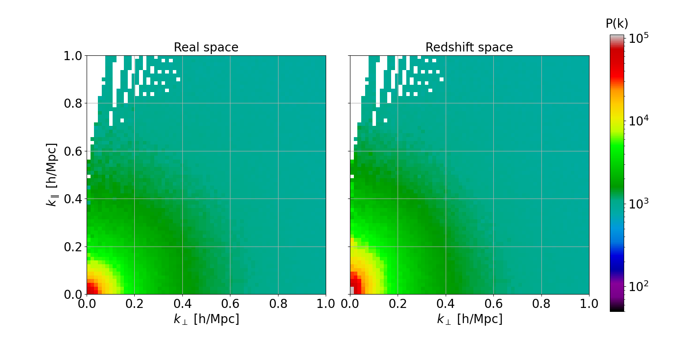
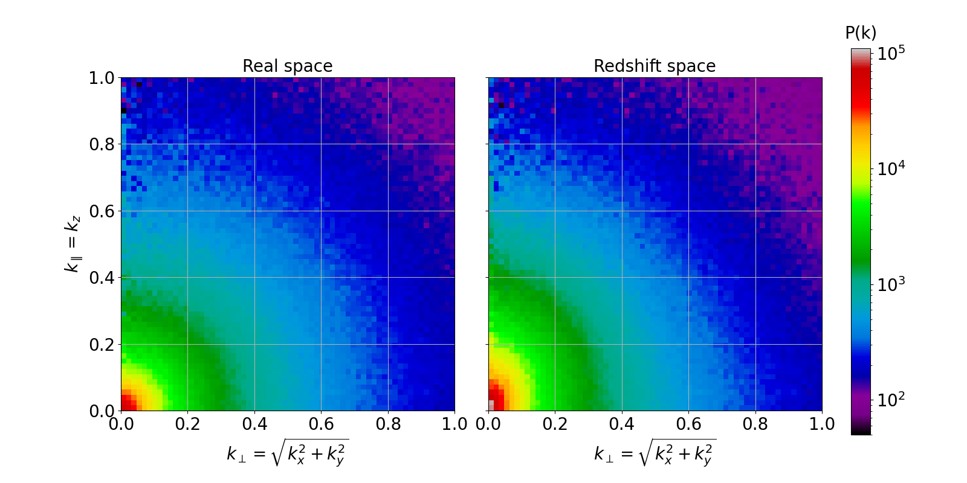
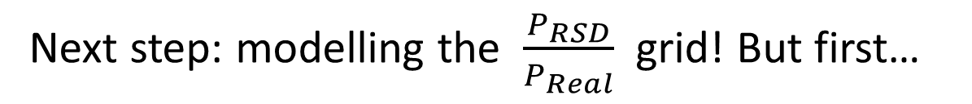
The real- and redshift position grids before (left) and after (right) re-binning
Next step: modelling the $\frac{P_{RSD}}{P_{Real}}$ grid! But first…

Slide 10
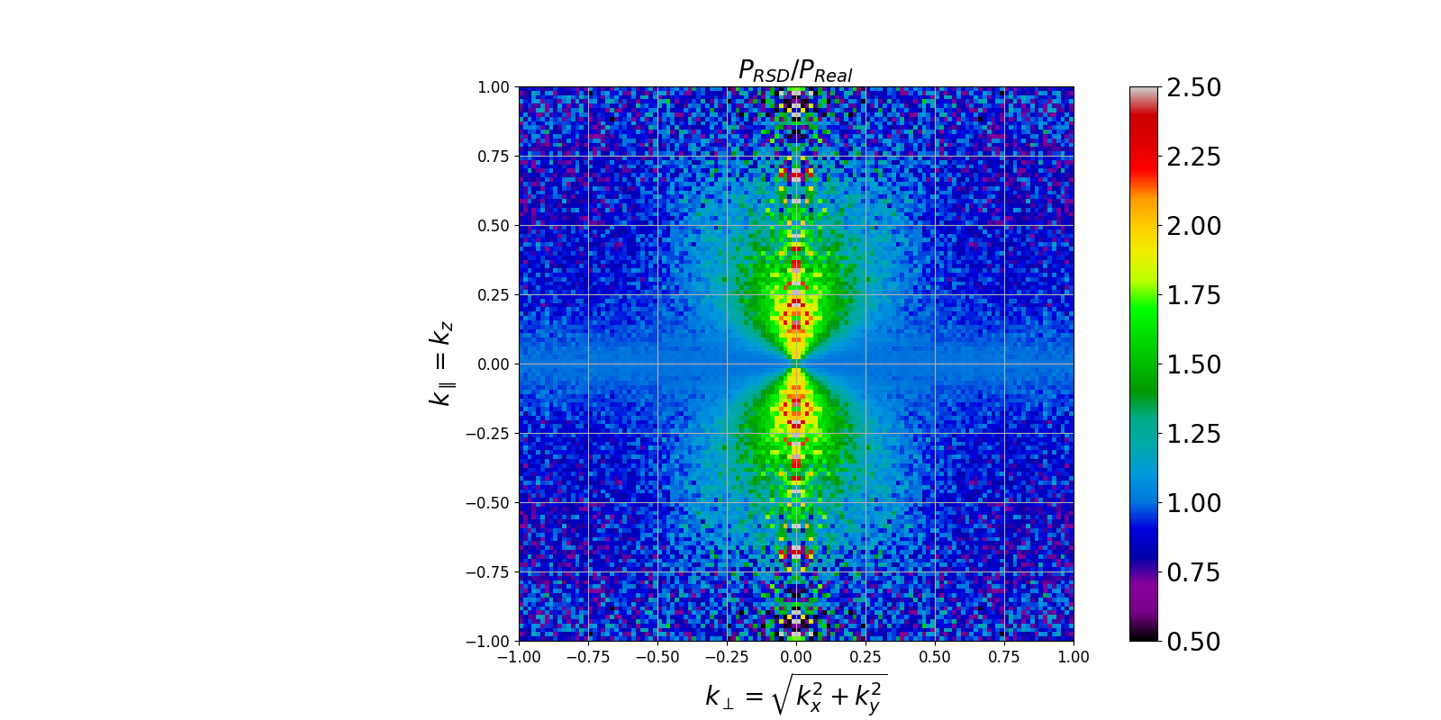
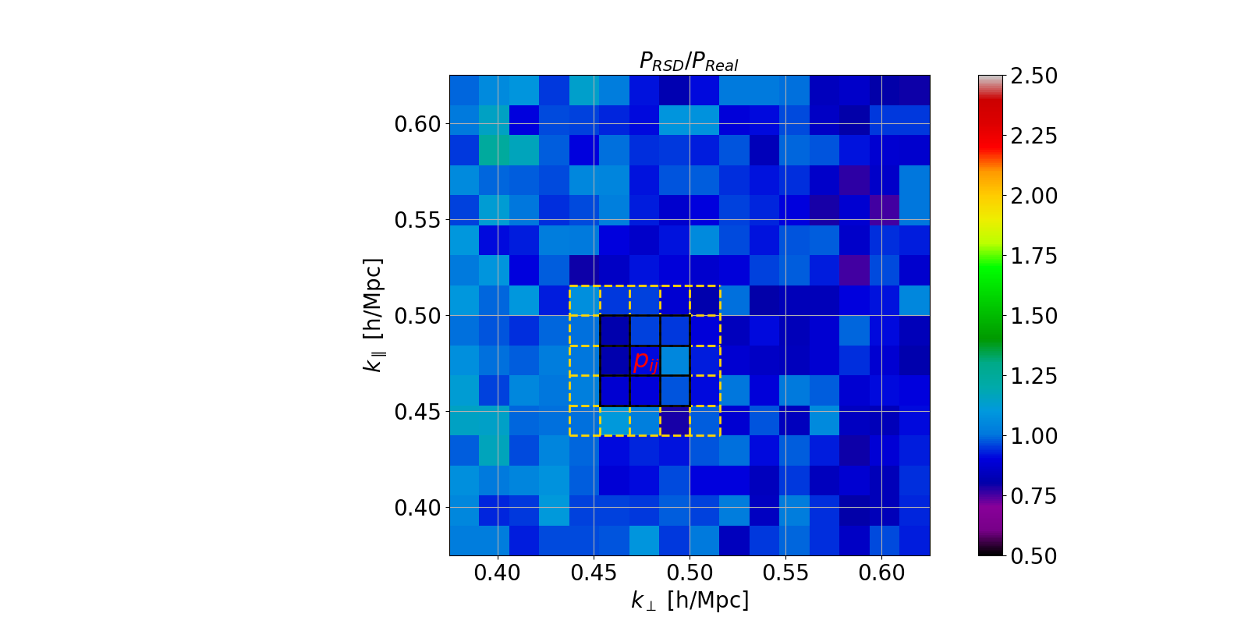
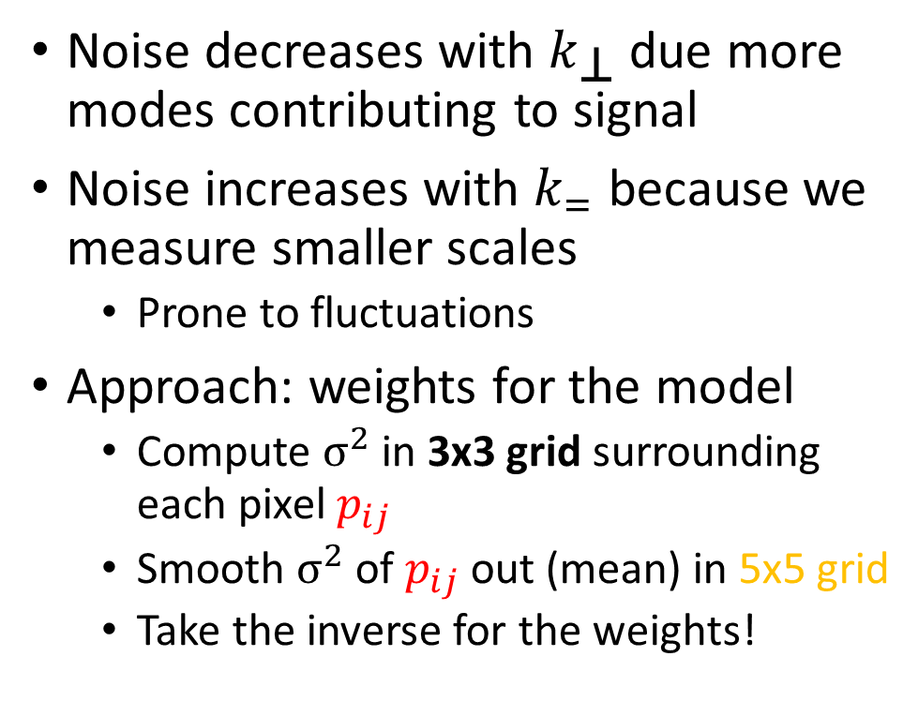
Methods: Weights
Noise decreases with $k_{\text{⊥}}$ due more modes contributing to signal
Noise increases with $k_{=}$ because we measure smaller scales
Prone to fluctuations
Approach: weights for the model
Compute $σ^{2}$ in 3x3 grid surrounding each pixel $p_{ij}$
Smooth $σ^{2}$ of $p_{ij}$out (mean) in 5x5 grid
Take the inverse for the weights!

Slide 11
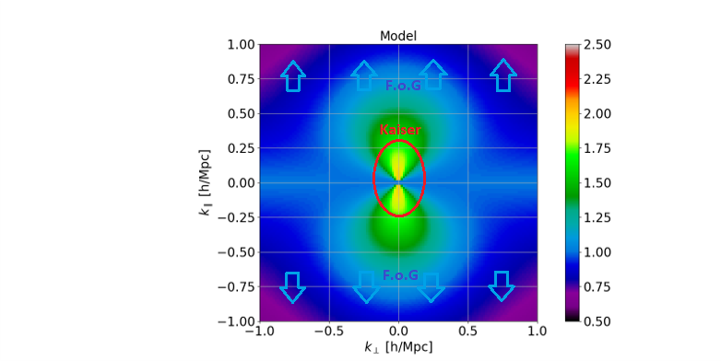
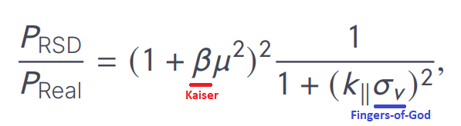
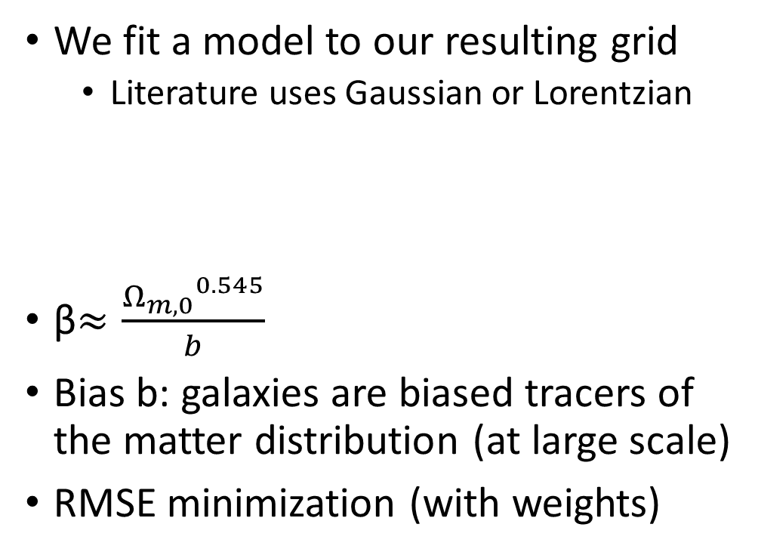
Methods: Redshift-Space Distortion model
We fit a model to our resulting grid
Literature uses Gaussian or Lorentzian
β$≈\frac{{Ω_{m,0}}^{0.545}}{b}$
Bias b: galaxies are biased tracers of the matter distribution (at large scale)
RMSE minimization (with weights)

Slide 12
Methods: different simulations
Mass bins
Low
Mid
High
Higher redshifts
z=0.5,1.0,2.0 (,0.8,1.5)
Vary AGN feedback strength in combination with mass
Expect greatest effect on high mass galaxies

Slide 13
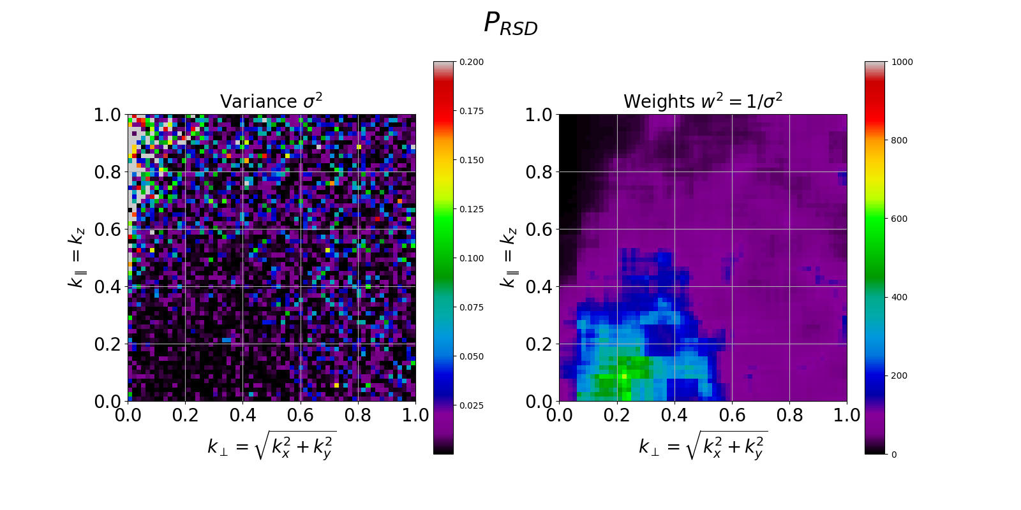
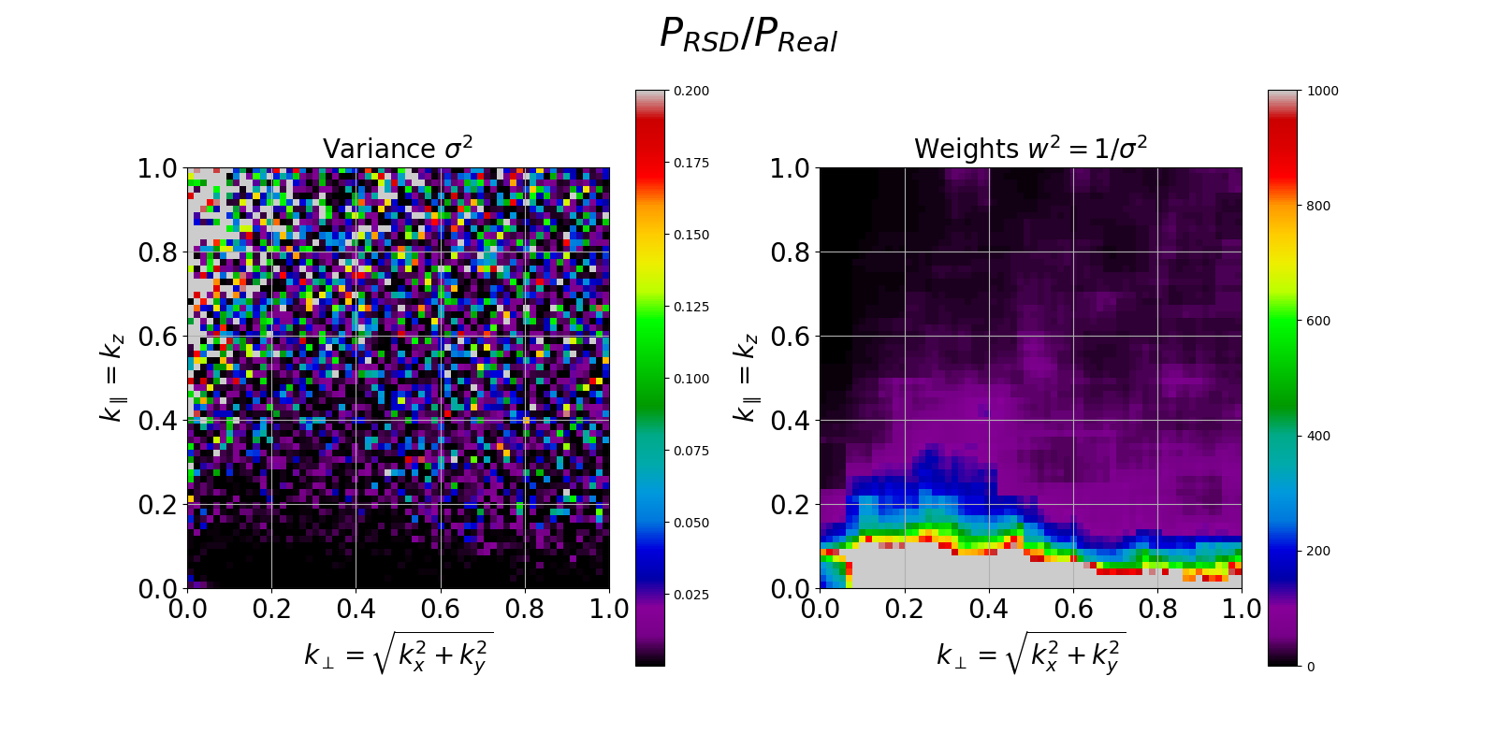
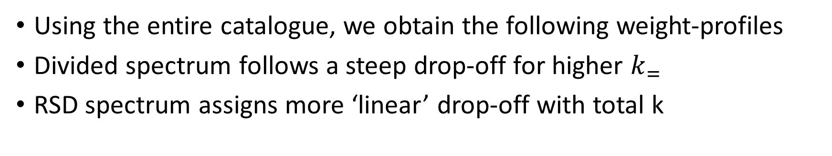
Results: Weight-grids
Using the entire catalogue, we obtain the following weight-profiles
Divided spectrum follows a steep drop-off for higher $k_{=}$
RSD spectrum assigns more ‘linear’ drop-off with total k

Slide 14
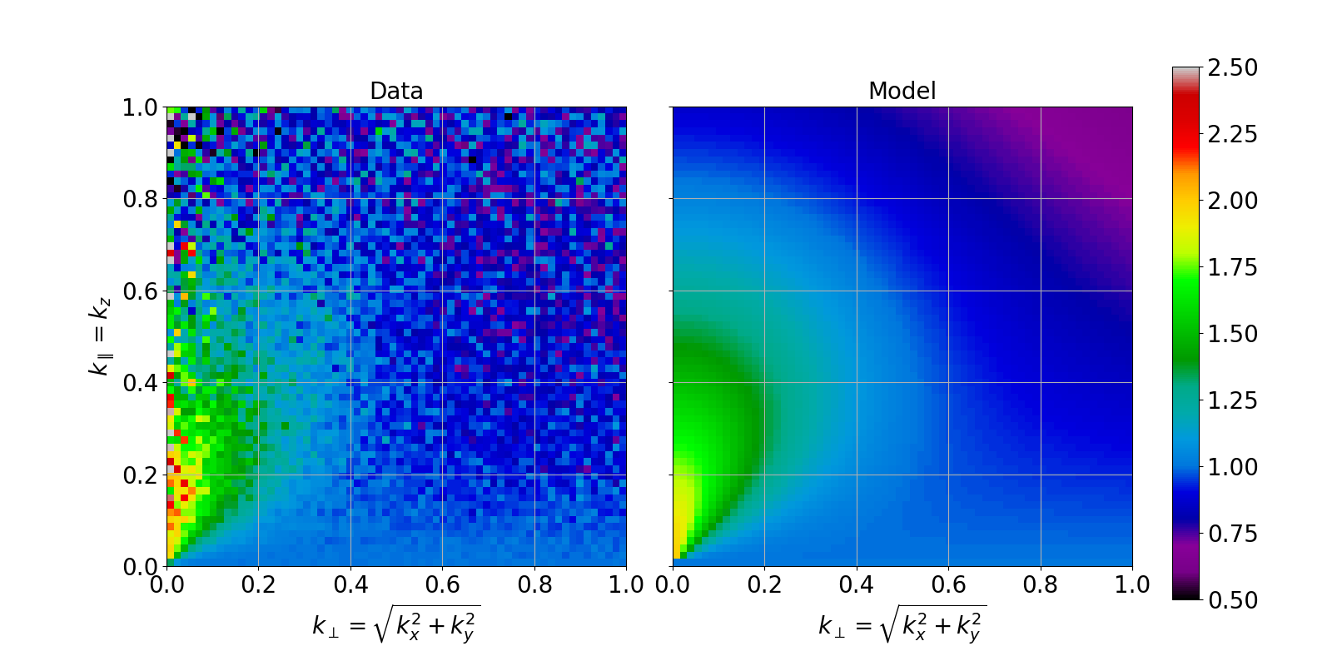
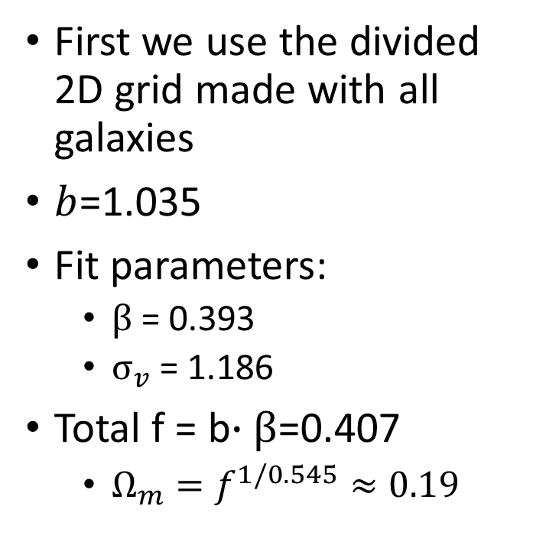
Results: Model of P_RSD/P_Real for all galaxies
First we use the divided 2D grid made with all galaxies
$b$=1.035
Fit parameters:
$β$= 0.393
$σ_{v}$ = 1.186
Total f = b$∙β$=0.407
$Ω_{m}^{}=f^{1/0.545}≈0.19$

Slide 15
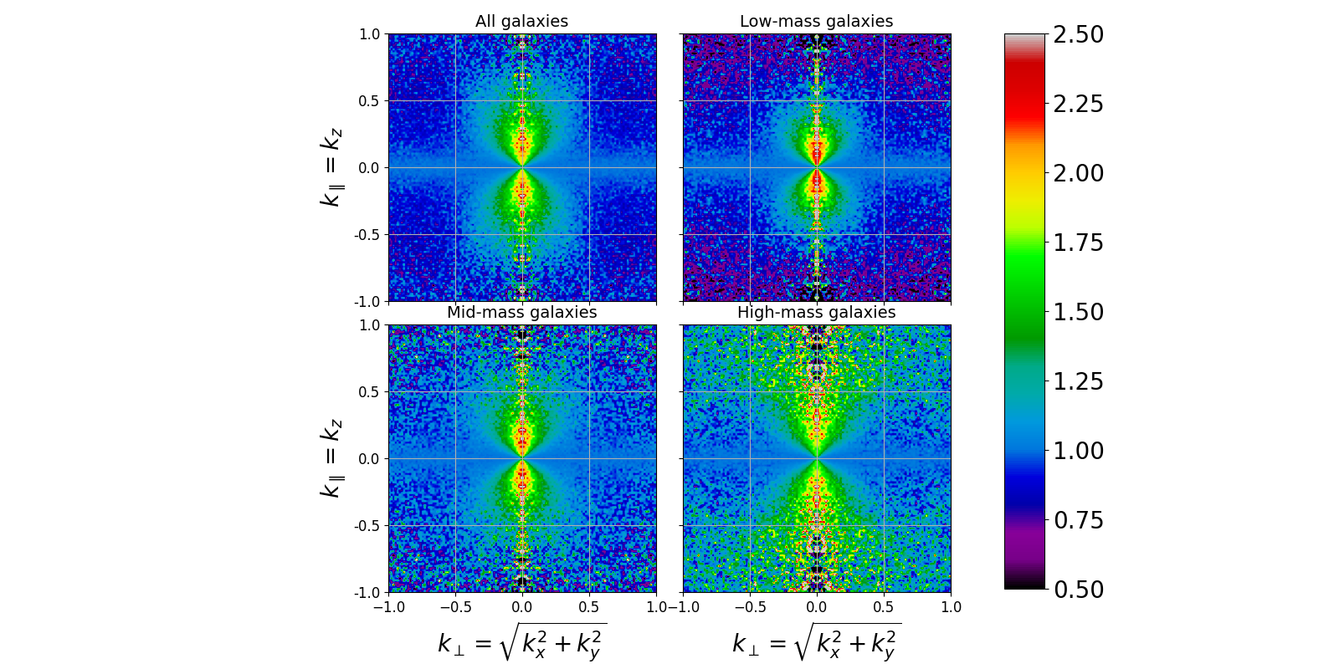

Results: different mass bins
Various mass bins
Stronger AGN feedback

Slide 16
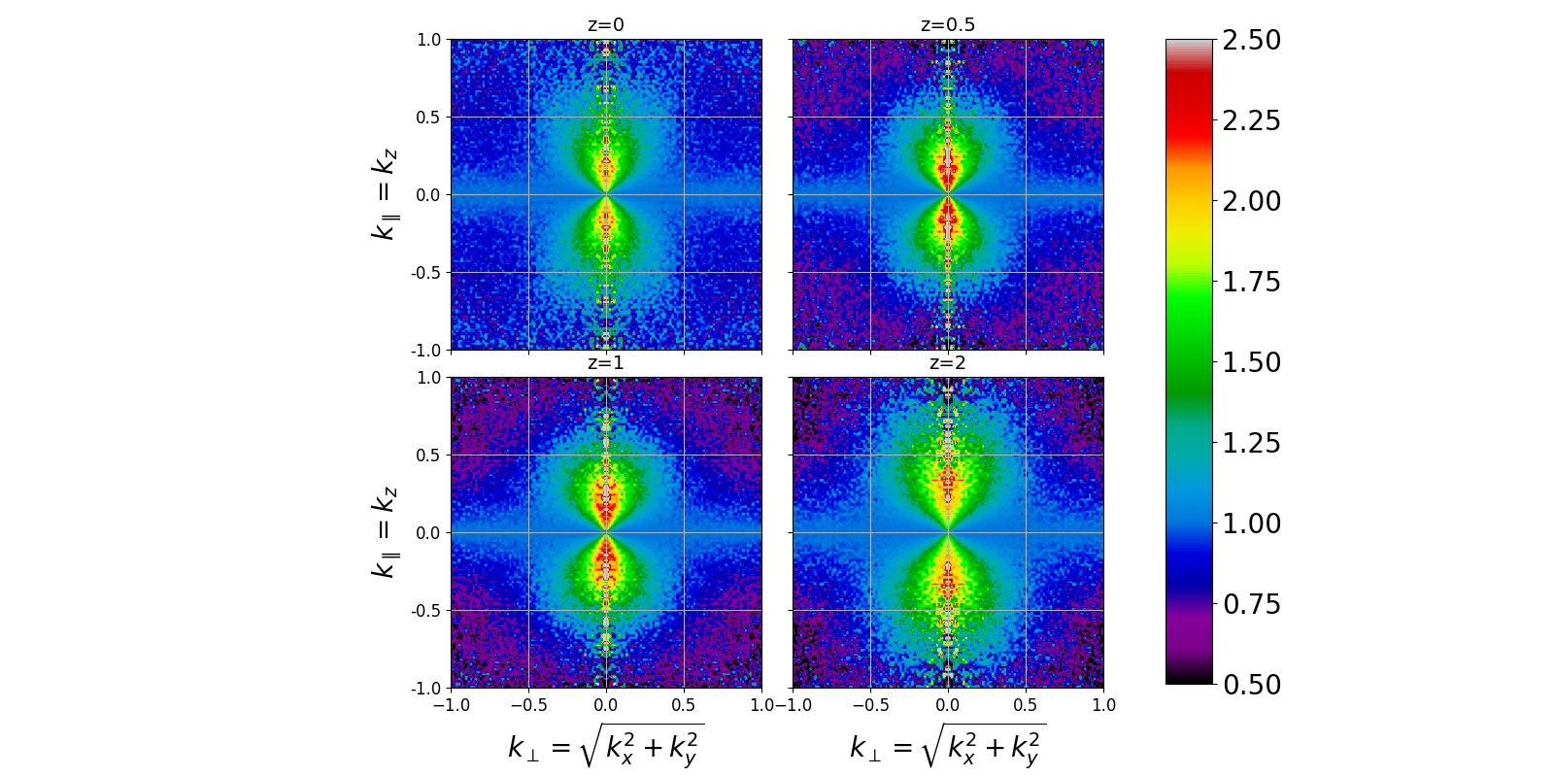
Results: higher redshifts

Slide 17
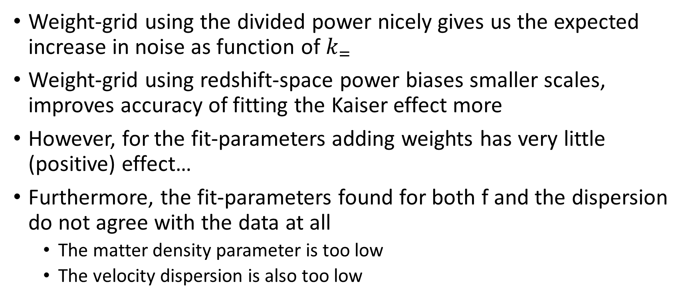
Discussion: Weights and fit parameters
Weight-grid using the divided power nicely gives us the expected increase in noise as function of $k_{=}$
Weight-grid using redshift-space power biases smaller scales, improves accuracy of fitting the Kaiser effect more
However, for the fit-parameters adding weights has very little (positive) effect…
Furthermore, the fit-parameters found for both f and the dispersion do not agree with the data at all
The matter density parameter is too low
The velocity dispersion is also too low

Slide 18
Discussion: different simulations
Difference between regular and stronger AGN feedback seems insignificant in terms of RSD
For higher mass galaxies, we expect dispersion to increase
High mass galaxies often near cluster centers and thus have greater random motion
We actually see the opposite: dispersion decreases
The model does follow the data pretty well, but the fit parameters do not match with expectations
For higher redshifts, we do see that the RSD peaks between z=0.5-1.0
Expected from the conversion formula

Slide 19
Conclusion:
We underestimate the strength of the RSD
Likely reason: we do not consider non-linear model terms
Follow-up project to explore these non-linear components would be valuable
There are some positives!
Divided grids follow noise expectations and match literature
Creative solution to quantify weights in a 2D grid
Pipeline to convert from simulation data to RSD grids (and models)

